Slide 1

BIP - HackYourCoffeemachine
Group C

Slide 2
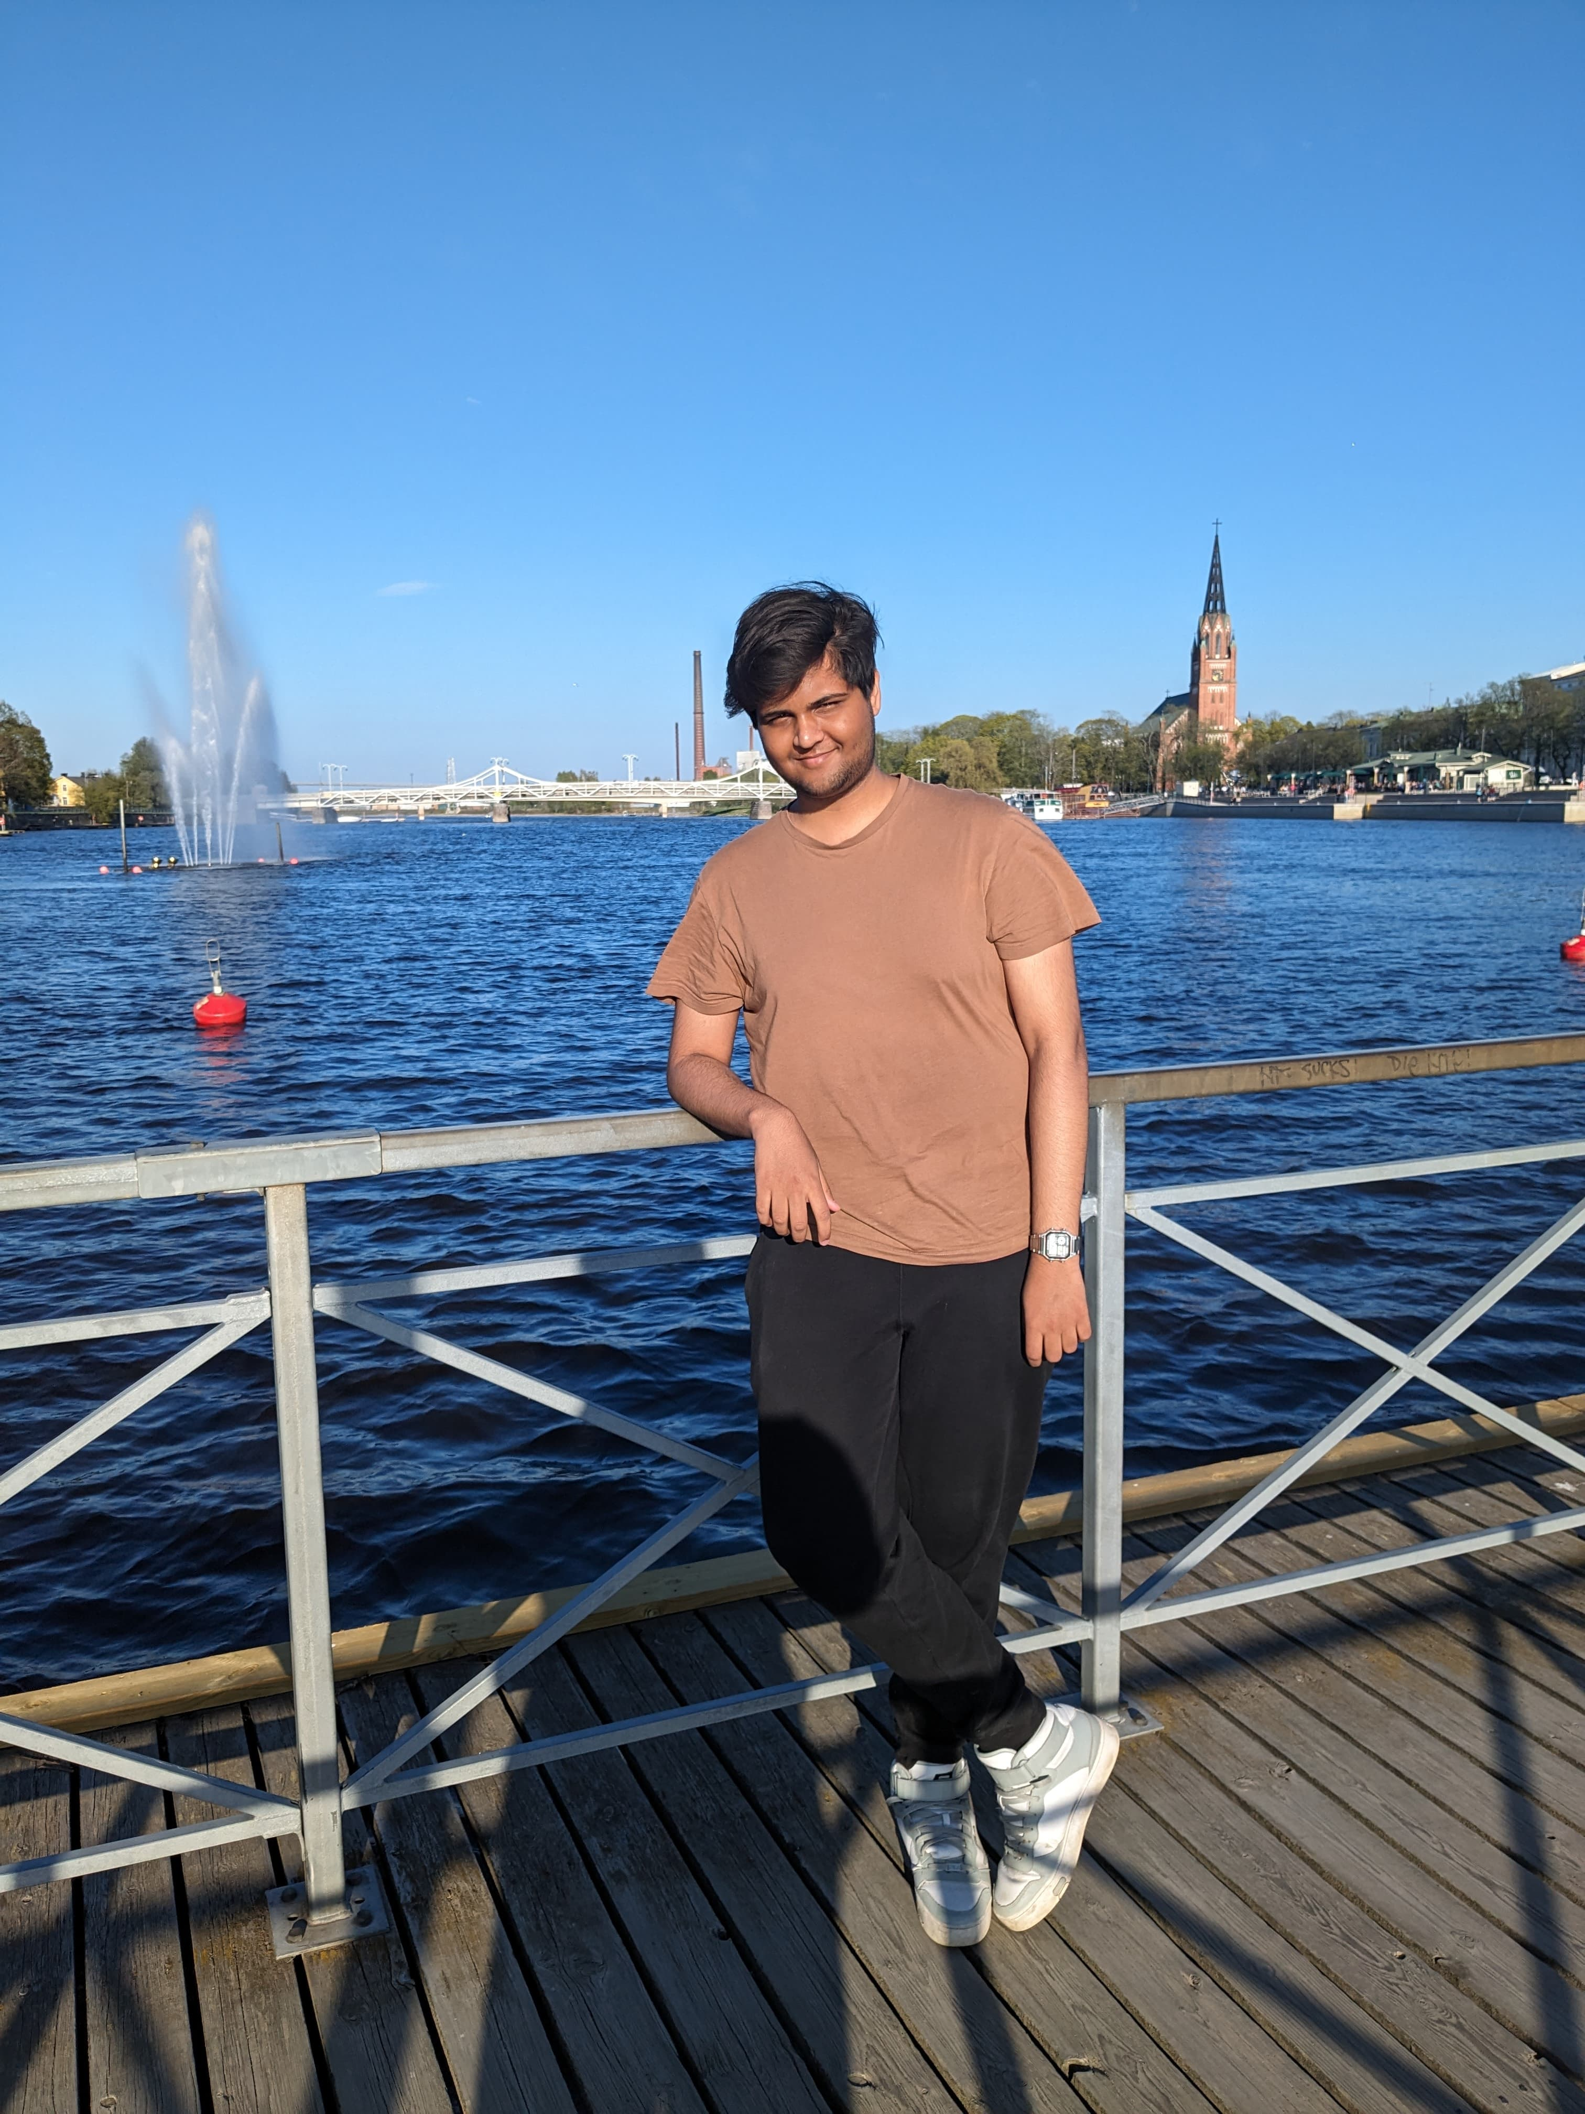
Akshat Gupta
Age: 19
Studies: Artificial Intelligence
University: SAMK
Semester: 3
Hobbies: Meeting new people, Basketball, Cooking

Slide 3
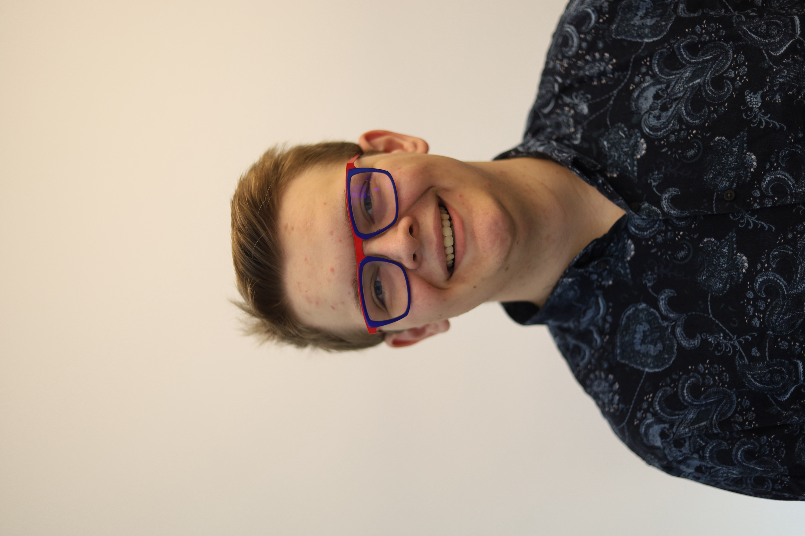
Ben Cloos
Age: 24
Studies: Mechatronics – M.Sc.
University: Fachhochschule Aachen
Semester: 2
Hobbies: Photography, Scouting, 3D Printing

Slide 4
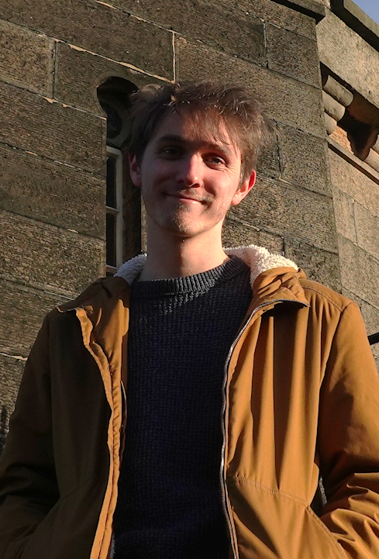
Dries Nuttin
Age: 22
Studies: Electronics-ICT
University: PXL Hasselt
Semester: 4
Hobbies: Playing music, Cooking, Electronics

Slide 5
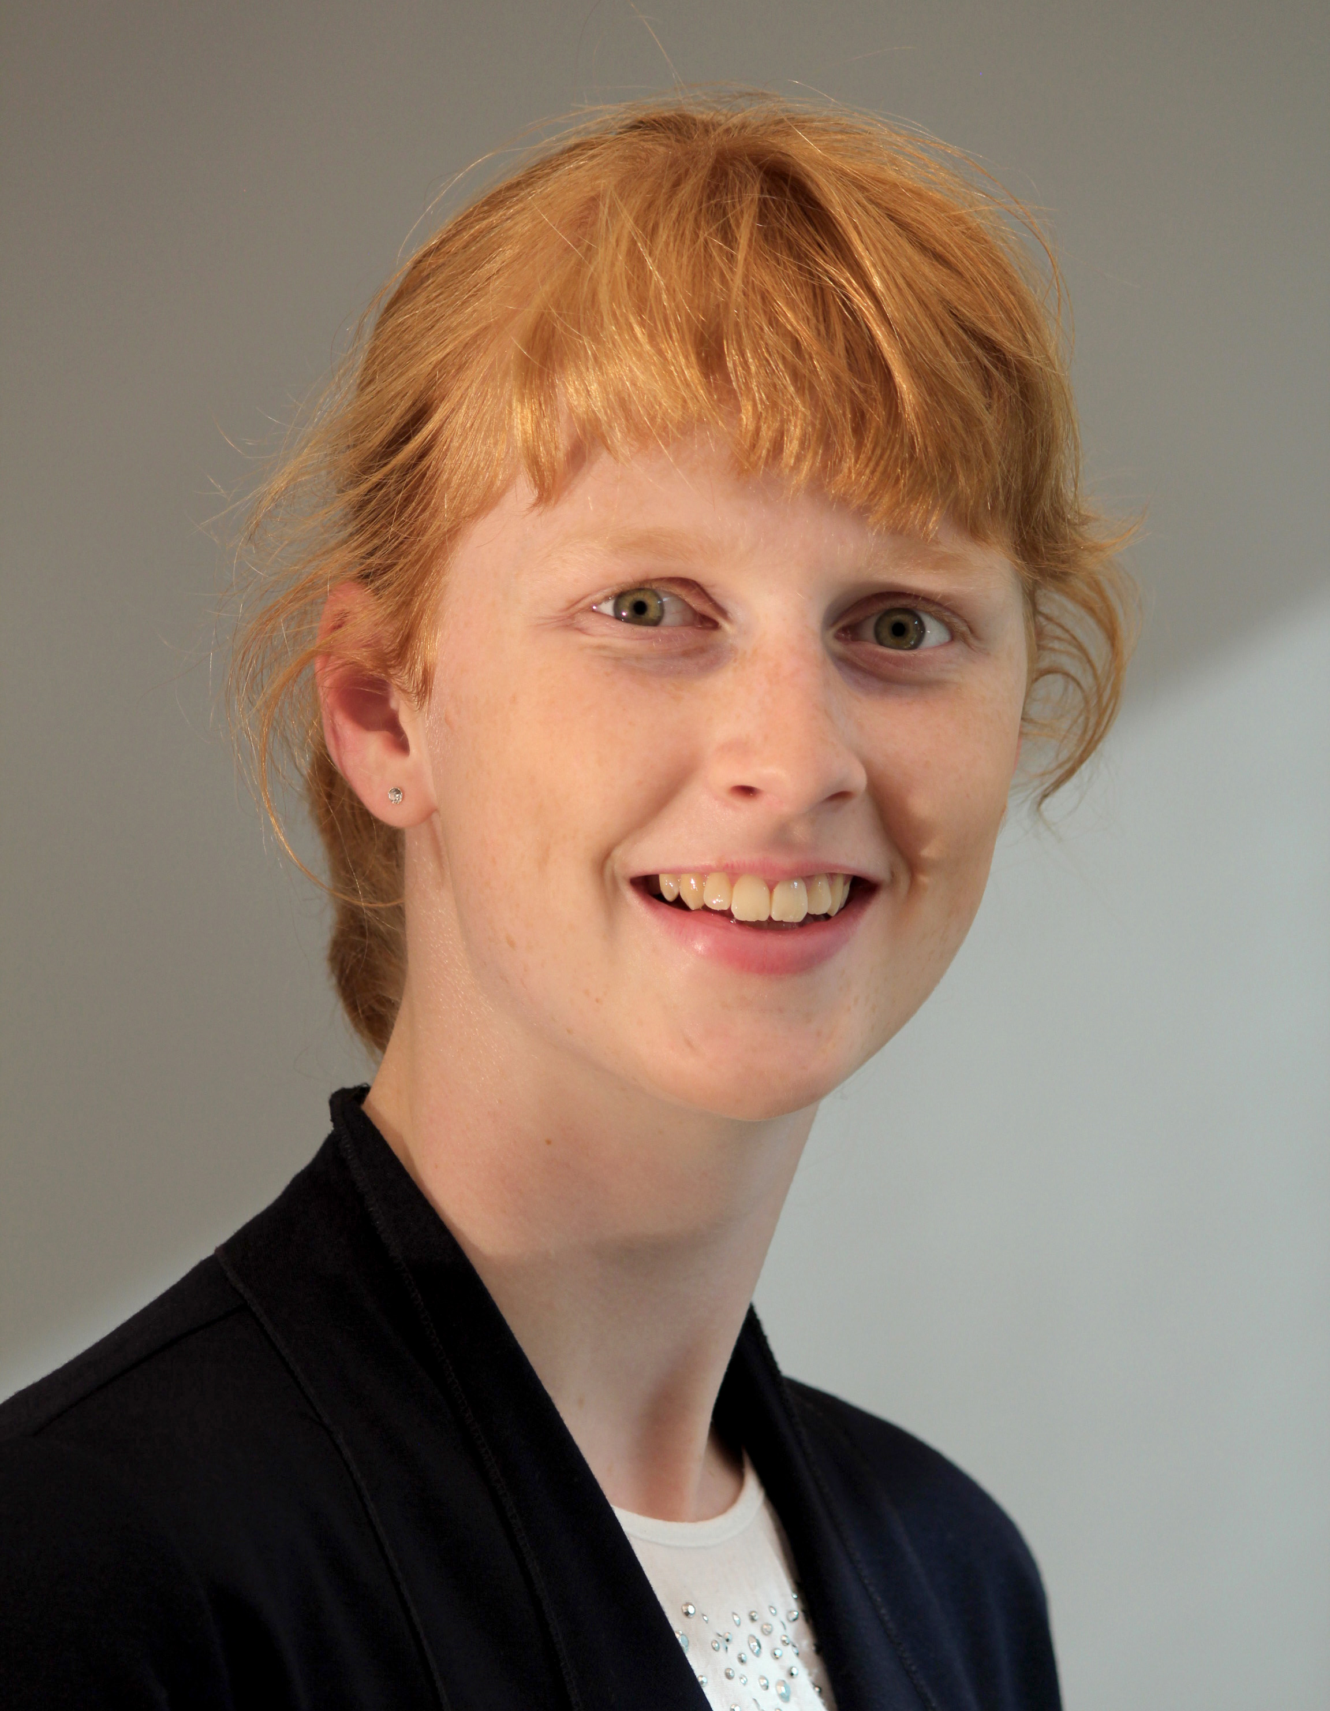
Katharina Jaeger
Age: 20
Studies: Industrial Engineering
University: Hochschule Bielefeld
Semester: 4
Hobbies: playing the accordion youth leader hiking

Slide 6
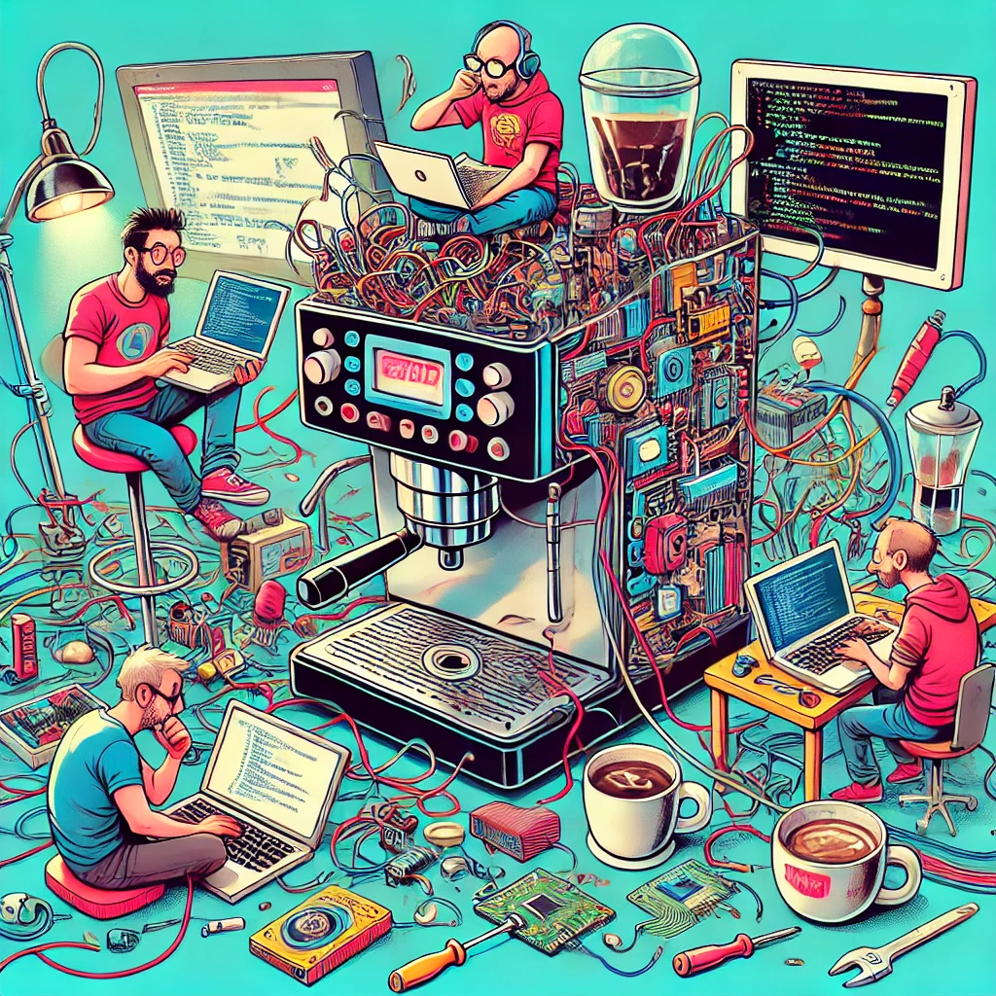
Thank you for your attention!

